Slide 1
AI powered contract analytics brings symphony across your contracts
-Docksiff

Slide 2
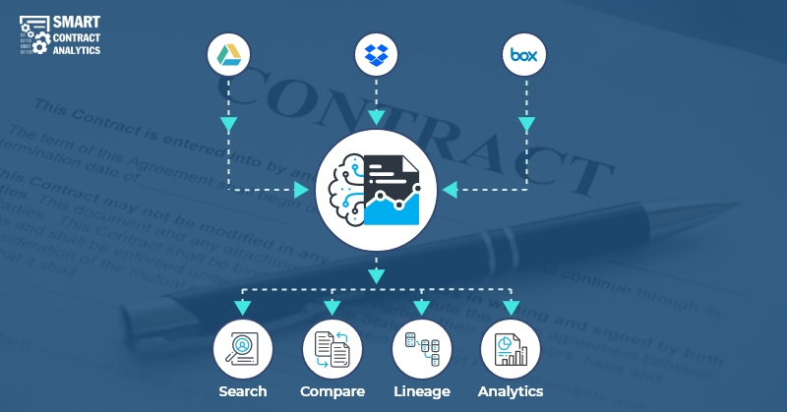

Slide 3
Symphony or Cacophony ?
Are your Contract Life Cycle Management (CLM) and Procure to Pay (P2P) digital platforms producing the right music?
Contracts are an integral part of any business relationship and being on top of your contracts is critical to the business. While working with some of the Fortune 500 organizations, we figured out that there is a lot of streamlining needed across their business contracts executed with various suppliers and vendors. Also, irrespective of the verticals including Insurance, Pharma, Medical Devices, Retail, Telecom and Hi-Tech, we have identified some common problems and pain points with respect to how they are managing their contracts.

Slide 4
Concerns with Contract Management – The Cacophony
Several organizations have spent millions of dollars and implemented a state-of-the-art Contract Life Cycle Management (CLM) system, but still have Active and Legacy contracts that they could not reliably migrate from their homegrown contract management systems. These contract management systems are typically a SharePoint portal, or the documents stored in shared network drives, DocuSign, Dropbox or one of the cloud storage systems.
Some of the meta data entered in manually was incorrect due to human errors. The typical example is when the P2P system sends a notification that a particular contract has expired, but in fact, the contract is still valid for another 2 years – this discrepancy is due to a manual entry of the data related to the term of the contract.

Slide 5
Lot of money was already spent on the migration of all the legacy contracts to the new contract management system, but do not have metadata for those contracts – The new system is not able to produce accurate reports that their CFO and CLO (Chief Legal / GC) are asking for – they would have to spend additional money on an outsourced paralegal team but they are on a short budget and turnaround times needs to be in days and not months.
There are situations where contracts with metadata exists, with a couple of large inconsistencies in the data sets. Stake holders are not sure on how many inconsistencies are present and whether they can trust their contract management system for day-to-day operations:
Typically, Expiration dates, payment dates, and termination notice periods are some of the metadata tracked by procurement teams within organizations and are unsure on how to resolve the inconsistencies.

Slide 6
One option would be to do it manually by opening each PDF file, and this needs many man hours
Another is to find a technology solution that can resolve the inconsistencies faster, cheaper, and with an accuracy that they can trust in.
Almost all the above concerns have a common underlying problem of extracting the metadata reliably, especially for the legacy contracts (many of them normally scanned and not legible). The reliability of any digital platform depends on the data that is going in and ensuring that the data is really a source of truth.

Slide 7
AI based Contract Analytics – The Symphony
The most efficient way to solve the underlying concerns with contract management is through applying AI/ML/NLP algorithms that read through the contracts and extract the needed metadata which can be further validated by augmented human services (i.e., humans in the loop).
The ROI on such state-of-the-art platforms is immediate due to the pain points that it can solve.
Smart Contract Analytics – The “Orchestration” Platform
We have built a great “orchestration” platform that plays the role of a “conductor” and brings all these disparate systems together and bring symphony from your contracts that is music to all the audience (i.e., legal, procurement, sales, and contract admin teams) in your organization.

Slide 8
For more information about how we can help you with bringing symphony across your contracts, please visit https://www.docskiff.ai
THANK YOU

